Slide 1
COMP 621U Week 3 Social Influence and Information Diffusion
Nathan Liu (nliu@cse.ust.hk)

Slide 2
What are Social Influences?
Influence:
People make decisions sequentially
Actions of earlier people affect that of later people
Two class of rational reasons for influence:
Direct benefit:
Phone becomes more useful if more people use it
Informational:
Choosing restaurants
Influences are the results of rational inferences from limited information.

Slide 3
Herding: Simple Experiment
Consider an urn with 3 ball. It can be either:
Majority-blue: 2 blue 1 red
Majority-red: 2 red, 1 blue
Each person wants to best guess whether the urn is majority is majority-blue or majority-red:
Experiment: One by one each person:
Draws a ball
Privately looks at its color ad puts it back
Publicly announces his guess
Everyone see all the guesses beforehand
How should you guess?

Slide 4
Herding: What happens?
What happens?
1st person: guess the color drawn
2nd person: guess the color drawn
3rd person:
If the two before made different guesses, then go with his own color
Else: just go with their guess (regardless of the color you see)
Can be modeled Bayesian rule(the first two guesses may bias the prior)
P(R|rrb)=P(rrb|R)P(R)/P(rrb)=2/3
Non-optimal outcome:
With prob 1/3×1/3=1/9, the first two would see the wrong color, from then on the whole population would guess wrong

Slide 5
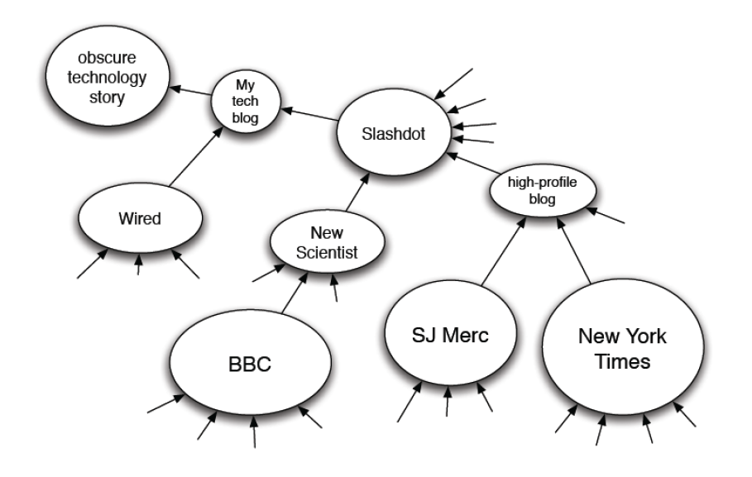
Examples: Information Diffusion

Slide 6
Example: Viral Propagation

Slide 7
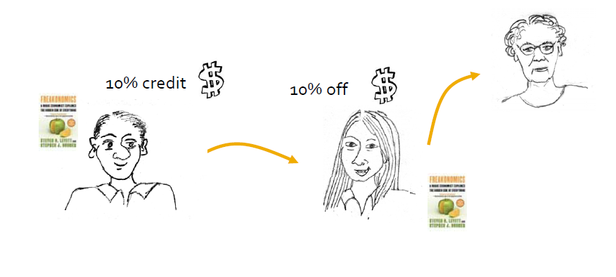
Example: Viral Marketing
Recommendation referral program:
Senders and followers of recommendations receive discounts on products

Slide 8
Early Empirical Studies of Diffusion and Influence
Sociological study of diffusion of innovation:
Spread of new agricultural practices[Ryan-Gross 1943]
Studied the adoption of a new hybrid-corn between the 259 farmers in Iowa
Found that interpersonal network plays important role
Spread of new medical practices [Coleman et al 1966]
Studied the adoption of new drug between doctors in Illinois
Clinical studies and scientific evaluation were not sufficient to convince doctors
It was the social power of peers that led to adoption
The contagion of obesity [Christakis et al. 2007]
If you have an overweight friend, your chance of becoming obese increase by 57%!

Slide 9

Applications of Social Influence Models
Forward Predictions: viral marketing, influence maximization
Backward Predictions: effector/initiator finding, sensor placement, cascade detection
Backward network engineering
Forward network engineering
Backward predictions
Learn from observed data
Forward predictions

Slide 10


Dynamics of Viral Marketing (Leskovec 07)
10
Senders and followers of recommendations receive discounts on products
10% credit
10% off
Recommendations are made to any number of people at the time of purchase
Only the recipient who buys first gets a discount

Slide 11
Statistics by Product Group
11
 | products | customers | recommenda-tions | edges | buy + get discount | buy + no discount
Book | 103,161 | 2,863,977 | 5,741,611 | 2,097,809 | 65,344 | 17,769
DVD | 19,829 | 805,285 | 8,180,393 | 962,341 | 17,232 | 58,189
Music | 393,598 | 794,148 | 1,443,847 | 585,738 | 7,837 | 2,739
Video | 26,131 | 239,583 | 280,270 | 160,683 | 909 | 467
Full | 542,719 | 3,943,084 | 15,646,121 | 3,153,676 | 91,322 | 79,164
people
recommendations
high
low

Slide 12
Does receiving more recommendations increase the likelihood of buying?
BOOKS
DVDs

Slide 13
Does sending more recommendations influence more purchases?
BOOKS
DVDs

Slide 14
The probability that the sender gets a credit with increasing numbers of recommendations
consider whether sender has at least one successful recommendation
controls for sender getting credit for purchase that resulted from others recommending the same product to the same person
probability of receiving a credit levels off for DVDs

Slide 15
Multiple recommendations between two individuals weaken the impact of the bond on purchases
BOOKS
DVDs

Slide 16
Processes and Dynamics
Influence (Diffusion, Cascade):
Each node get to make decisions based on which and how many of its neighbors adopted a new idea or innovation.
Rational decision making process.
Known mechanics.
Infection (Contagion, Propagation):
Randomly occur as a result of social contact.
No decision making involved.
Unknown mechanics.

Slide 17
Mathematical Models
Models of Influence [Easley10a]:
Independent Cascade Model
Threshold Model
Questions:
Who are the most influential nodes?
How to detect cascade?
Models of Infection [Easley 10b]:
SIS: Susceptible-Infective-Susceptible (e.g., flu)
SIR: Susceptible-Infective-Recovered (e.g., chickenpox)
Questions:
Will the virus take over the network?

Slide 18
Common Properties of Influence Modeling
A social network is represented a directed graph, with each actor being one node;
Each node is started as active or inactive;
A node, once activated, will activate his neighboring nodes;
Once a node is activated, this node cannot be deactivated.

Slide 19
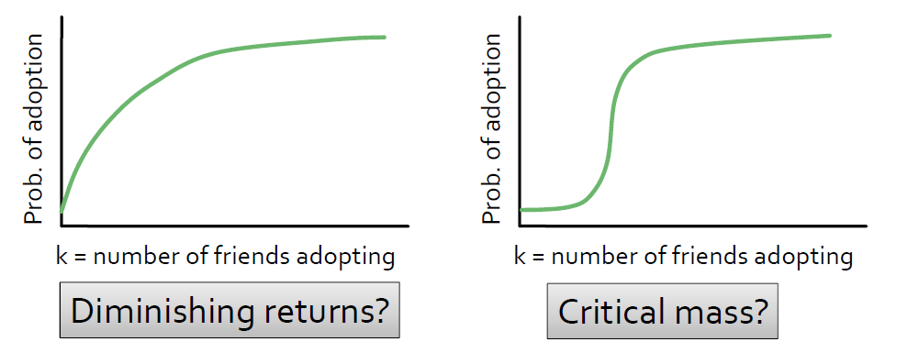
Diffusion Curves
Basis for models:
Probability of adopting new behavior depends on the number of friends who already adopted
What is the dependence?
Different shapes has consequences for models of diffusion

Slide 20
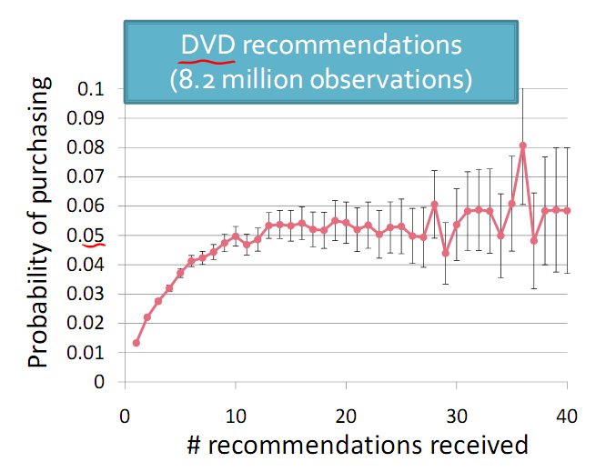
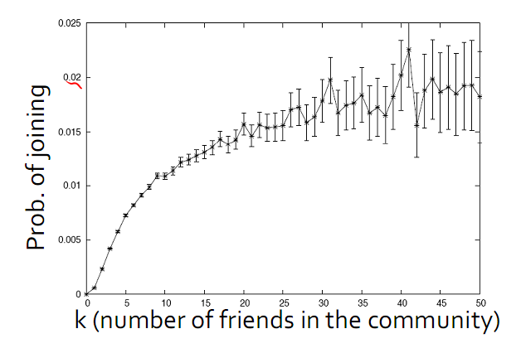
Real World Diffusion Curves
DVD recommendation and LiveJournal community membership

Slide 21
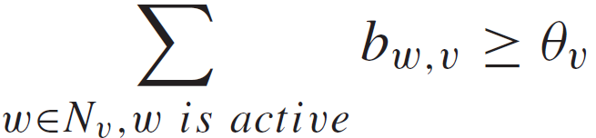
Linear Threshold Model
An actor would take an action if the number of his friends who have taken the action exceeds (reaches) a certain threshold
Each node v chooses a threshold ϴ_{v} randomly from a uniform distribution in an interval between 0 and 1.
In each discrete step, all nodes that were active in the previous step remain active
The nodes satisfying the following condition will be activated

Slide 22
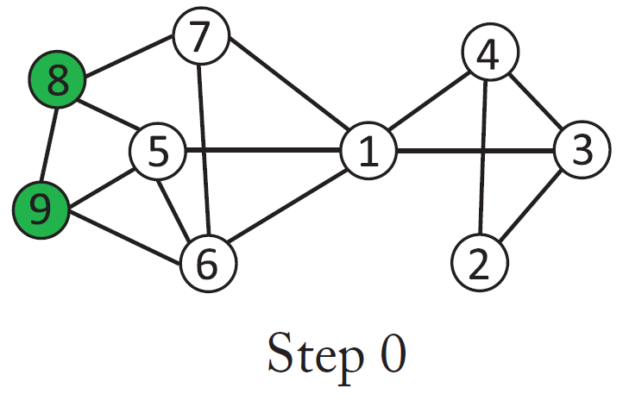
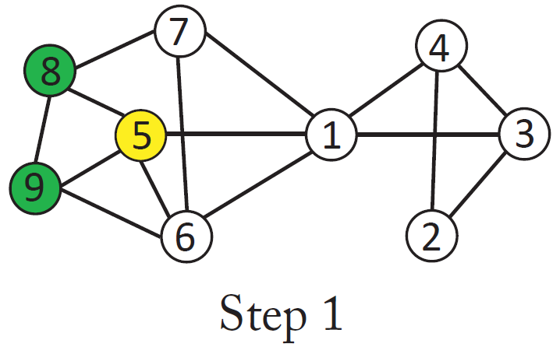
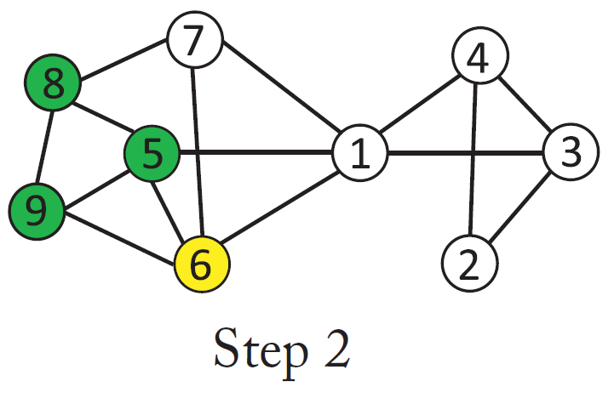
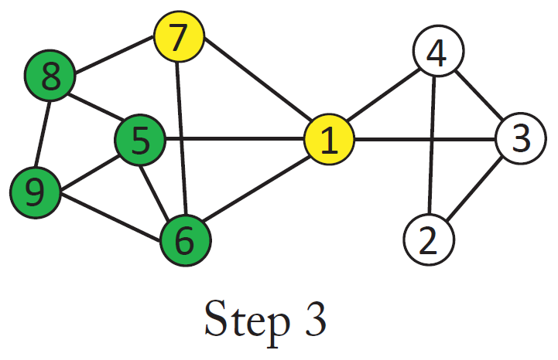
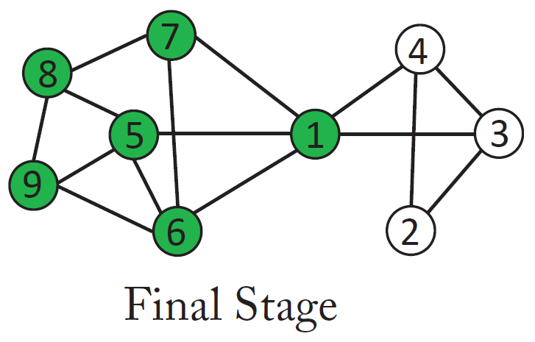
Linear Threshold Diffusion Process

Slide 23
Independent Cascade Model
The independent cascade model focuses on the sender’s rather than the receiver’s view
A node w, once activated at step t , has one chance to activate each of its neighbors randomly
For a neighboring node (say, v), the activation succeeds with probability p_{w,v} (e.g. p = 0.5)
If the activation succeeds, then v will become active at step t + 1
In the subsequent rounds, w will not attempt to activate v anymore.
The diffusion process, starts with an initial activated set of nodes, then continues until no further activation is possible

Slide 24
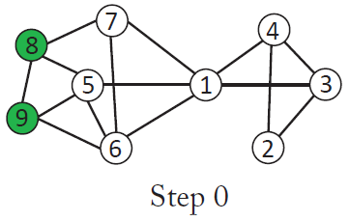
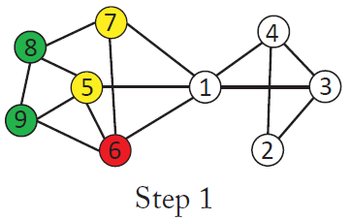
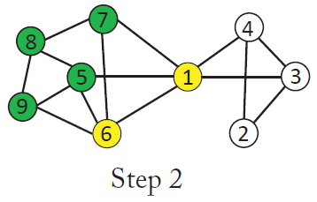
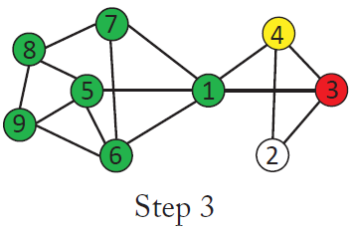
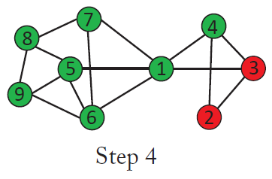
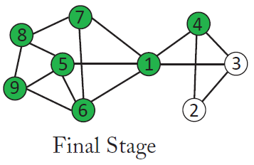
Independent Cascade Model Diffusion Process

Slide 25
How should we organize revolt?
You live an in oppressive society
You know of a demonstration against the government planned tomorrow
If a lot of people show up, the government will fall
If only a few people show up, the demonstrators will be arrested and it would have been better had everyone stayed at home

Slide 26
Pluralistic Ignorance
You should do something if you believe you are in the majority!
Dictator tip: Pluralistic ignorance – erroneous estimates about the prevalence of certain opinions in the population
Survey conducted in the U.S. in 1970 showed that while a clear minority of white Americans at that point favored racial segregation, significantly more than 50% believed it was favored by a majority of white Americans in their region of the country.

Slide 27
Organizing the Revolt: The Model
Personal threshold k: “I will show up if am sure at least k people in total (including myself) will show up”
Each node only knows the thresholds and attitudes of all their direct friends.
Can we predict if a revolt can happened based on the network structure?

Slide 28
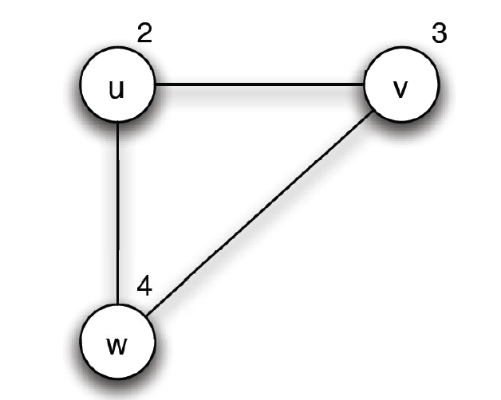
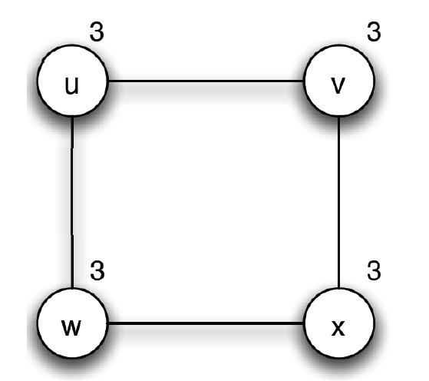
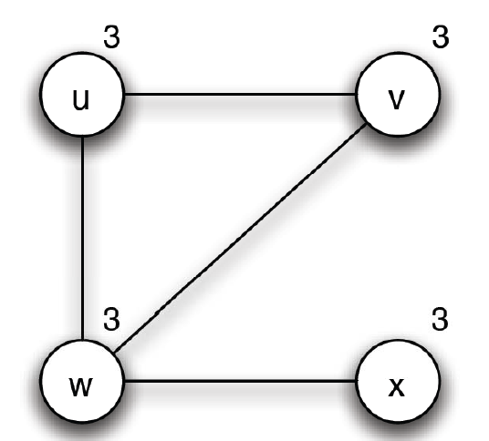
Which Network Can Have a Revolt?

Slide 29
Influence Maximization (Kempe03)
If S is initial active set let σ(S) denote expected size of final active set
Most influential set of size k: the set S of k nodes producing largest expected cascade size σ (S) if activated.
A discrete optimization problem
NP-Hard and highly inapproximable

Slide 30
An Approximation Result
Diminishing returns:
Hill-climbing: repeatedly select node with maximum marginal gain
Analysis: diminishing returns at individual nodes cascade size σ (S) grows slower and slower with S (i.e. f is submodular)
Theorem: if f is a monotonic submodular function, the k-step hill climbing produces set S for which σ (S) is within (1-1/e) of optimal
σ(S) for both threshold and independent cascade model are submodular.

Slide 31
Submodularity for Independent Cascade
0.6
Coins for edges are flipped during activation attempts.
Can pre-flip all coins and reveal results immediately.
0.3
0.2
0.2
0.1
0.4
0.5
0.3
0.5
Active nodes in the end are reachable via green paths from initially targeted nodes.
Study reachability in green graphs
Notes:
Our proof deals with these difficulties by formulating an equivalent
view of the process, which makes it easier to see that there
is an order-independent outcome, and which provides an alternate
way to reason about the submodularity property.
From the point of view of the process, it clearly does not matter whether the
coin was flipped at the moment that v became active, or whether it
was flipped at the very beginning of the whole process and is only
being revealed now. With all the coins flipped in advance, the process can be viewed
as follows. The edges in G for which the coin flip indicated an
activation will be successful are declared to be live; the remaining
edges are declared to be blocked. If we fix the outcomes of the coin
flips and then initially activate a set A, it is clear how to determine
the full set of active nodes at the end of the cascade process:
CLAIM 2.3. A node x ends up active if and only if there is a
path from some node in A to x consisting entirely of live edges.
(We will call such a path a live-edge path.)

Slide 32
Submodularity, Fixed Graph
Fix “green graph” G. g(S) are nodes reachable from S in G.
Submodularity: g(T +v) - g(T) g(S +v) - g(S) when S T.
g(S +v) - g(S): nodes reachable from S + v, but not from S.
From the picture: g(T +v) - g(T) g(S +v) - g(S) when S T (indeed!).
Notes:
g(S +v) - g(S): Exactly nodes reachable from v, but not from S.

Slide 33
Submodularity of the Function
Fact: A non-negative linear combination of submodular functions is submodular
g_{G}(S): nodes reachable from S in G.
Each g_{G}(S): is submodular (previous slide).
Probabilities are non-negative.

Slide 34
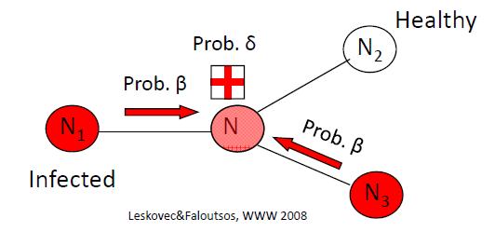
Models of Infection (Virus Propagation)
How do virus/rumors propagate?
Will a flu-like virus linger or will it die out soon?
(Virus) birth rate β : probability that an infected neighbor attacks
(Virus) death rate δ : probability that an infected neighbor recovers

Slide 35
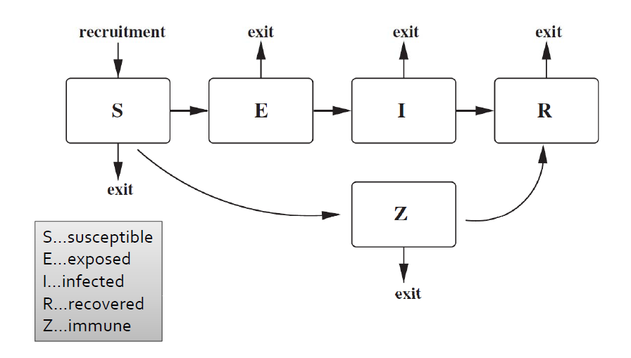
General Schemes

Slide 36
Susceptible-Infected-Recovered (SIR) Model
Process:
Initially, some nodes are in the I state and all others in the S state.
Each node v in the I state remains infectious for a fixed number of steps t
During each of the t steps, node v can infect each of its susceptible neighbors with probability p.
After t steps, v is no longer infectious or susceptible to further infections and enters state R.
SIR is suitable for modeling a disease that each individual can only catches once during their life time.

Slide 37
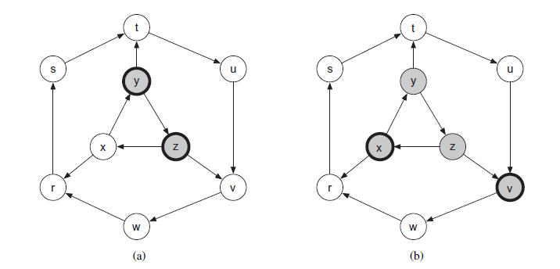
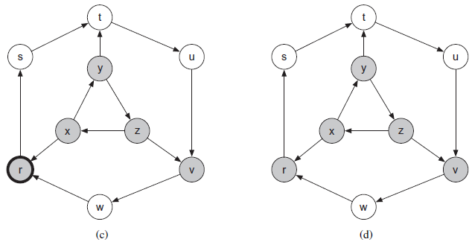
Example SIR epidemic, t=1

Slide 38
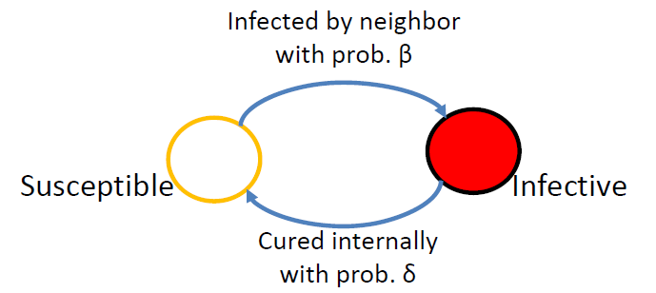
Susceptible-Infected-Susceptible (SIS) Model
Cured nodes immediately become susceptible again.
Virus “strength”: s= β/ δ

Slide 39
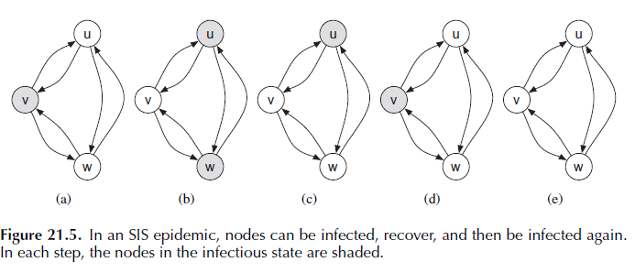
Example SIS Epidemic

Slide 40
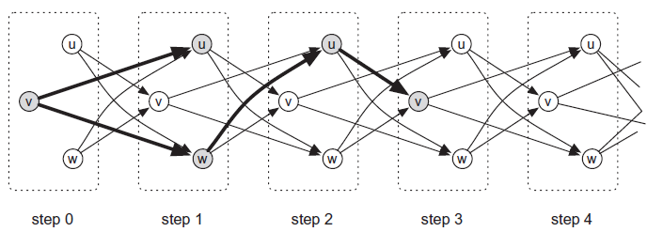
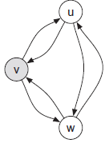
Connection between SIS and SIR
SIS model with t=1 can be represented as an SIS model by creating a separate copy of each node for each time step.

Slide 41
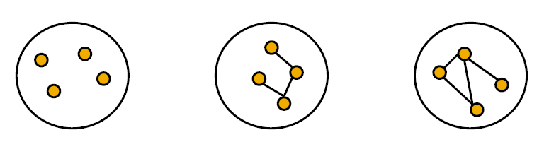
Question: Epidemic Threshold
The epidemic threshold of a graph is a value of τ, such that
If strength s= β/ δ< τ, then an epidemic can not happen
What should τ depend on?
Avg. degree? And/or highest degree?
And/or variance of degree?
And/or diameter?

Slide 42
Epidemic threshold in SIS model
We have no epidemic if:
Epidemic threshold
Death rate
Birth rate
Largest eigenvalue of
adjacency matrix A

Slide 43
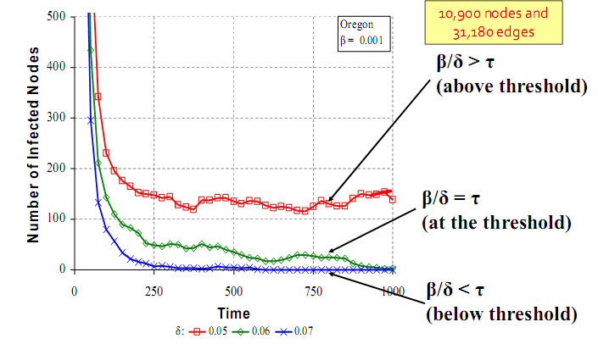
Simulation Studies:

Slide 44
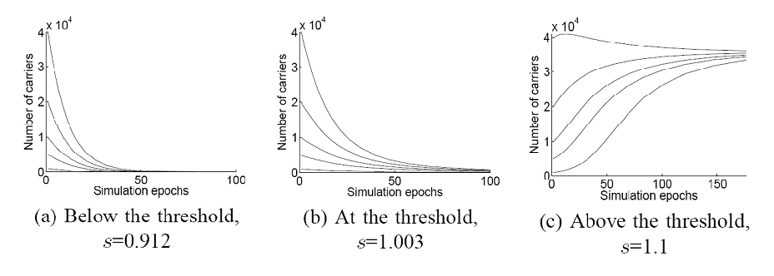
Experiments:
Does it matter how many people are initially infected?

Slide 45
References:
[Kempe03] D. Kempe, J. Kleinberg, E. Tardos. Maximizing the Spread of Influence Through a Social Network. KDD’03
[Leskovec06] J. Leskovec, L. Adamic, B. Huberman. The Dynamics of Viral Marketing. EC’06
[Easley10a] D. Easley, J. Kleinberg. Networks, Crowds and Markets, Ch19
[Easley10b] D. Easley, J. Kleinberg. Networks, Crowds and Markets, Ch20

